Slide 1
Chapter 3
3.3 Motion and Forces
Forces

Slide 2
Forces
Think about your daily activities
Pushing open a door, kicking a soccer ball, pulling open a drawer
All of these actions result in a force being applied to some object

Slide 3
Forces
A force is a push or a pull that one objects exerts (or applies) on another
Force is a vector
It has a size (strength) AND a direction
Ex: when you lift your backpack, you apply an upward force
Force is measured in newtons (N)

Slide 4
Forces
Changing Motion
When you apply force to a moving object, it can cause the motion to change (but not always!)
What happens to the motion and direction of the ball when the tennis player hits it?

Slide 5
Forces
Balanced Forces
Force does not always cause a change in velocity
When 2 or more forces act on an object at the same time, they combine to form a net force (net = total)
In the picture below, the net force is zero because the two forces acting on the opposite sides of the refrigerator are equal, so they cancel out
When forces on an object are equal in size and opposite in direction, they are called balanced forces

Slide 6
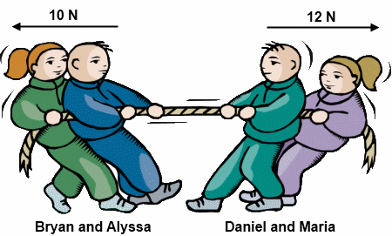
Forces
Unbalanced Forces
When unequal forces are applied to an object, the net force occurs in the direction of the larger force
If the net force is NOT zero, we call this an unbalanced force
Which side will win the tug of war? Why/how do you know?

Slide 7
Forces
Unbalanced forces change velocity
If forces acting on an object are balanced (net force is zero), velocity doesn’t change
BUT if the forces are unbalanced, then you will see a change in velocity
Think about what would happen if you and a friend were on opposite sides of the door pushing…
With the same force? ____________________________________________________
With different amounts of force? ____________________________________________

Slide 8
Forces
Recap
What is the difference between a balanced force and unbalanced force?

Slide 9
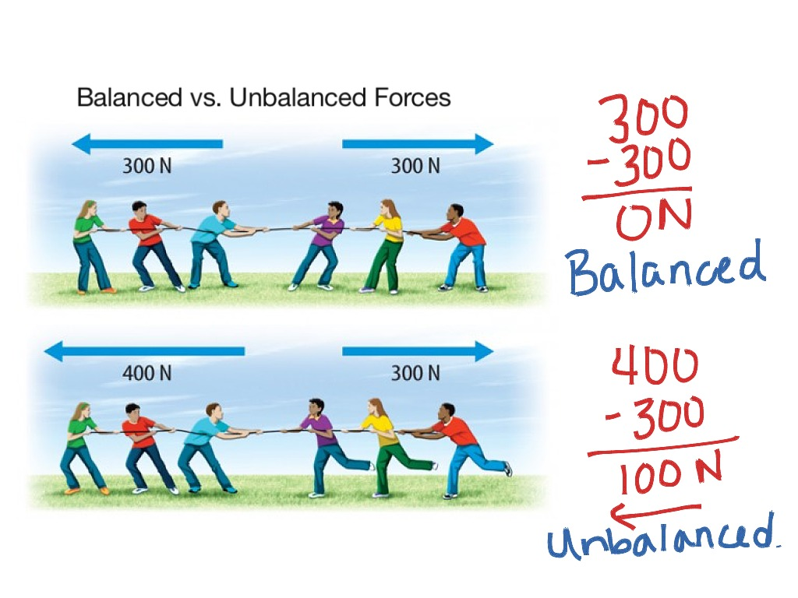
Forces

Slide 10
Forces
5 N
4 N
8 N
15 N
15 N
7 N
Net force:
Change in motion:
Net force:
Change in motion:
Net force:
Change in motion:
10 N
20 N
4 N
Net force:
Change in motion:

